Slide 1
Forest Park Southeast, Botanical Heights, Central West End, Medical Campus
Monthly Crime Report: June 2020
Washington University Medical Center

Slide 2
Forest Park Southeast: Summary Notes
19 total crimes in June 2020
-46% change compared to June 2019 (35 total crimes)
6 crime(s) against persons in June 2020
-33% change compared to June 2019 (9 crimes against persons)
134 total crimes in 2020
16% change compared to this time in 2019 (116 total crimes)
25 crime(s) against persons in 2020
14% change compared to this time in 2019 (22 crimes against persons)

Slide 3
Forest Park Southeast: Year to Year Comparison
2019 | 2019 | 2019 | 2019 | 2019 | 2019 | 2019 | 2019 | 2019 | 2019 | 2019 | 2019 | 2019 | 2019
Part 1 Crimes | Jan | Feb | Mar | Apr | May | Jun | Jul | Aug | Sep | Oct | Nov | Dec | Total
Aggravated Assault | 0 | 3 | 1 | 2 | 2 | 4 | 2 | 0 | 2 | 5 | 0 | 5 | 26
Arson | 0 | 0 | 1 | 0 | 0 | 1 | 0 | 0 | 0 | 0 | 0 | 0 | 2
Burgalry | 0 | 0 | 1 | 1 | 0 | 0 | 3 | 1 | 4 | 8 | 3 | 1 | 22
Homicide | 0 | 0 | 0 | 0 | 0 | 0 | 0 | 0 | 1 | 0 | 0 | 0 | 1
Larceny | 7 | 10 | 15 | 12 | 9 | 21 | 17 | 19 | 24 | 35 | 17 | 32 | 218
Motor Vehicle Theft | 3 | 6 | 1 | 2 | 0 | 4 | 6 | 1 | 8 | 3 | 3 | 0 | 37
Robbery | 1 | 0 | 1 | 1 | 2 | 5 | 2 | 1 | 2 | 3 | 1 | 2 | 21
Total | 11 | 19 | 20 | 18 | 13 | 35 | 30 | 22 | 41 | 54 | 24 | 40 | 327
2020 | 2020 | 2020 | 2020 | 2020 | 2020 | 2020 | 2020
Part 1 Crimes | Jan | Feb | Mar | Apr | May | Jun | Total
Aggravated Assault | 1 | 5 | 3 | 0 | 0 | 6 | 15
Arson | 0 | 0 | 0 | 0 | 0 | 0 | 0
Burgalry | 3 | 1 | 4 | 1 | 0 | 0 | 9
Homicide | 0 | 0 | 0 | 0 | 0 | 0 | 0
Larceny | 25 | 15 | 14 | 10 | 8 | 11 | 83
Motor Vehicle Theft | 2 | 5 | 2 | 3 | 3 | 2 | 17
Robbery | 1 | 6 | 1 | 0 | 2 | 0 | 10
Total | 32 | 32 | 24 | 14 | 13 | 19 | 134

Slide 4
Forest Park Southeast: Summary Tables
Day of the Week | Number of Crimes
Sun | 2
Mon | 4
Tue | 0
Wed | 3
Thu | 1
Fri | 2
Sat | 7
Total | 19
Part 1 Crimes | Number of Crimes
Aggravated Assault | 6
Larceny | 11
Motor Vehicle Theft | 2
Total | 19
Crimes Against Persons | Number of Crimes
FALSE | 13
TRUE | 6
Total | 19
Time of Day | Number of Crimes
Day | 10
Night | 9
Total | 19

Slide 5
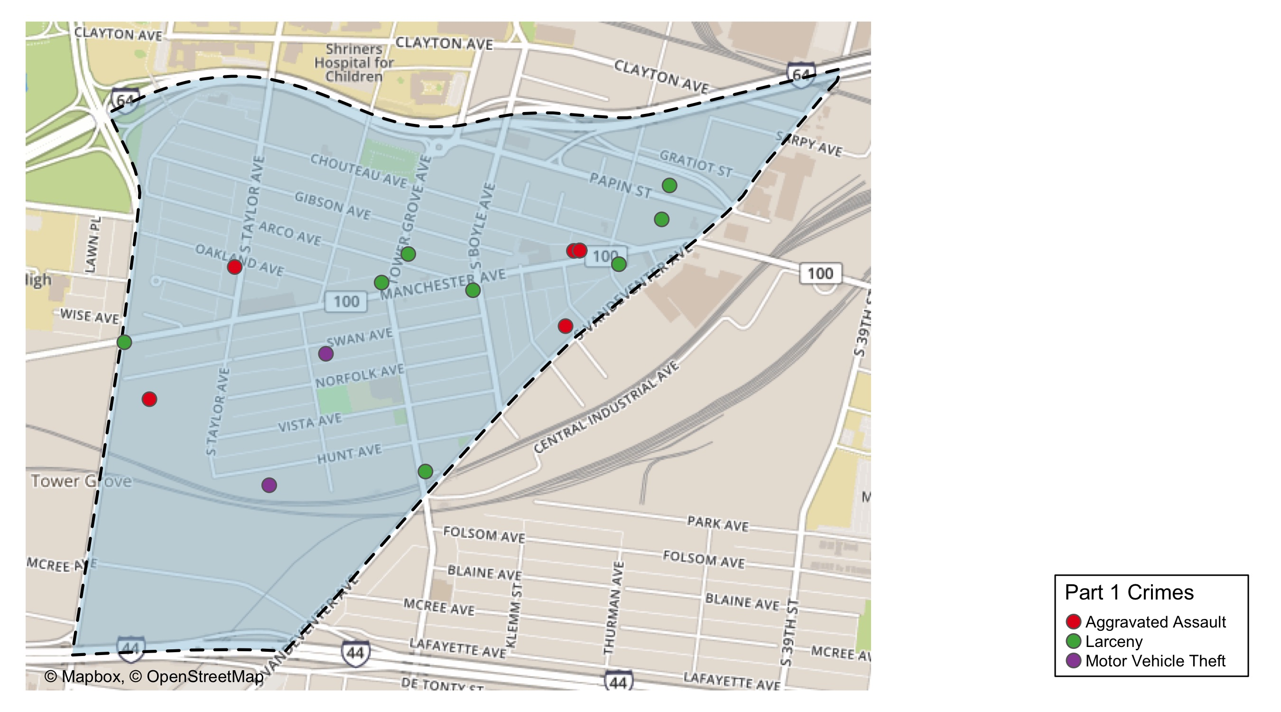
Forest Park Southeast: Total Crime Map

Slide 6
Botanical Heights: Summary Notes
3 total crimes in June 2020
-40% change compared to June 2019 (5 total crimes)
1 crime(s) against persons in June 2020
0% change compared to June 2019 (1 crimes against persons)
27 total crimes in 2020
-31% change compared to this time in 2019 (39 total crimes)
5 crime(s) against persons in 2020
-38% change compared to this time in 2019 (8 crimes against persons)

Slide 7
Botanical Heights: Year to Year Comparison
2019 | 2019 | 2019 | 2019 | 2019 | 2019 | 2019 | 2019 | 2019 | 2019 | 2019 | 2019 | 2019 | 2019
Part 1 Crimes | Jan | Feb | Mar | Apr | May | Jun | Jul | Aug | Sep | Oct | Nov | Dec | Total
Aggravated Assault | 0 | 0 | 0 | 0 | 4 | 0 | 0 | 1 | 0 | 0 | 2 | 1 | 8
Arson | 0 | 0 | 0 | 0 | 0 | 0 | 0 | 0 | 0 | 0 | 0 | 0 | 0
Burgalry | 2 | 0 | 0 | 2 | 0 | 0 | 1 | 1 | 3 | 0 | 1 | 2 | 12
Homicide | 0 | 0 | 0 | 0 | 0 | 0 | 0 | 0 | 0 | 0 | 0 | 0 | 0
Larceny | 2 | 3 | 6 | 3 | 3 | 3 | 9 | 1 | 5 | 4 | 3 | 5 | 47
Motor Vehicle Theft | 1 | 1 | 3 | 0 | 1 | 1 | 0 | 1 | 0 | 1 | 1 | 2 | 12
Robbery | 0 | 2 | 0 | 0 | 1 | 1 | 0 | 0 | 0 | 3 | 0 | 1 | 8
Total | 5 | 6 | 9 | 5 | 9 | 5 | 10 | 4 | 8 | 8 | 7 | 11 | 87
2020 | 2020 | 2020 | 2020 | 2020 | 2020 | 2020 | 2020
Part 1 Crimes | Jan | Feb | Mar | Apr | May | Jun | Total
Aggravated Assault | 1 | 0 | 0 | 1 | 0 | 1 | 3
Arson | 0 | 0 | 0 | 0 | 0 | 0 | 0
Burgalry | 1 | 0 | 1 | 0 | 0 | 0 | 2
Homicide | 1 | 0 | 0 | 0 | 0 | 0 | 1
Larceny | 2 | 6 | 2 | 2 | 3 | 1 | 16
Motor Vehicle Theft | 0 | 0 | 0 | 0 | 2 | 1 | 3
Robbery | 1 | 0 | 1 | 0 | 0 | 0 | 2
Total | 6 | 6 | 4 | 3 | 5 | 3 | 27

Slide 8
Botanical Heights: Summary Tables
Day of the Week | Number of Crimes
Sun | 0
Mon | 1
Tue | 0
Wed | 0
Thu | 1
Fri | 1
Sat | 0
Total | 3
Part 1 Crimes | Number of Crimes
Aggravated Assault | 1
Larceny | 1
Motor Vehicle Theft | 1
Total | 3
Crimes Against Persons | Number of Crimes
FALSE | 2
TRUE | 1
Total | 3
Time of Day | Number of Crimes
Day | 3
Total | 3

Slide 9
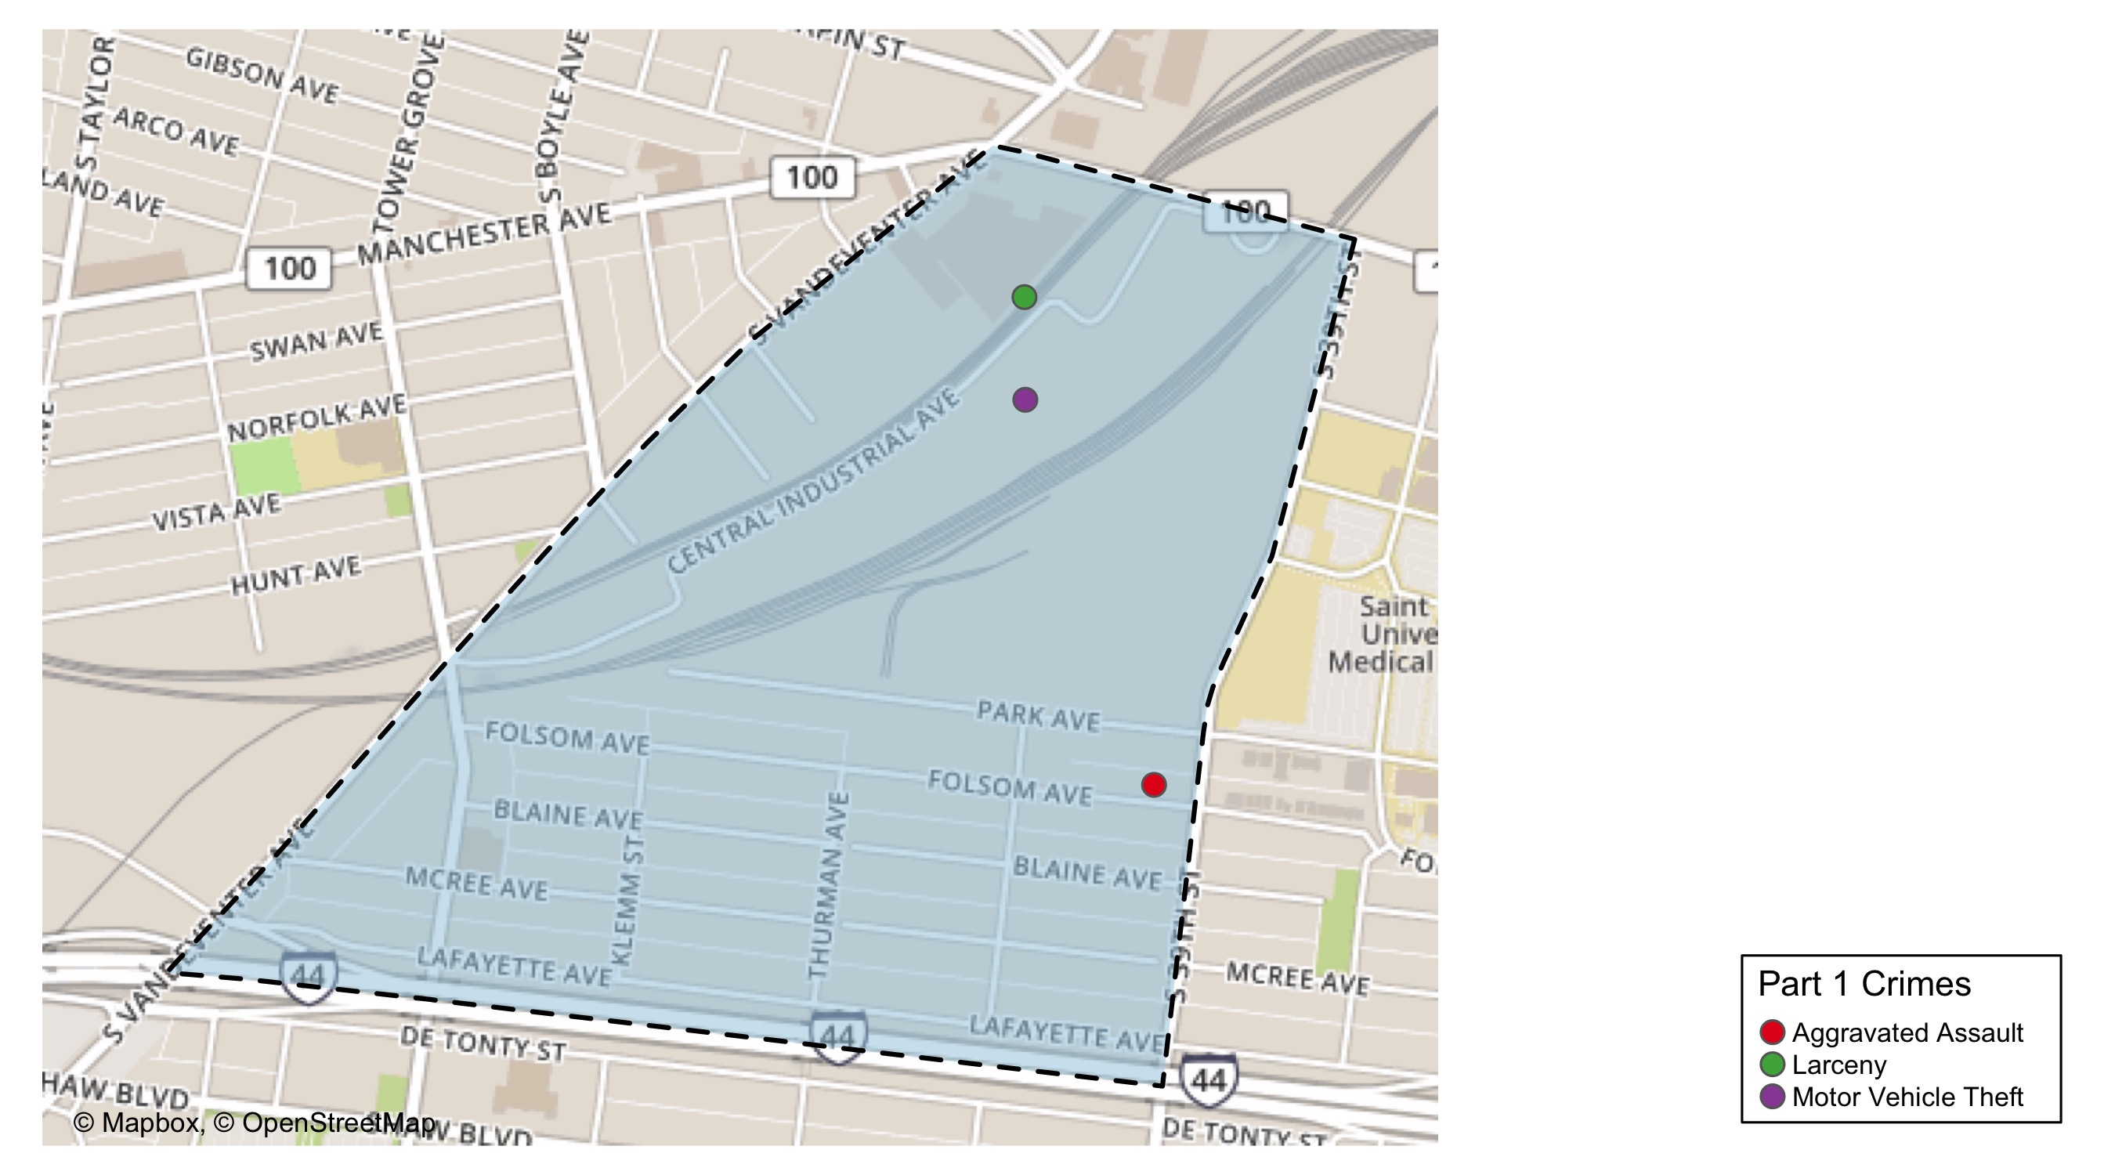
Botanical Heights: Total Crime Map

Slide 10
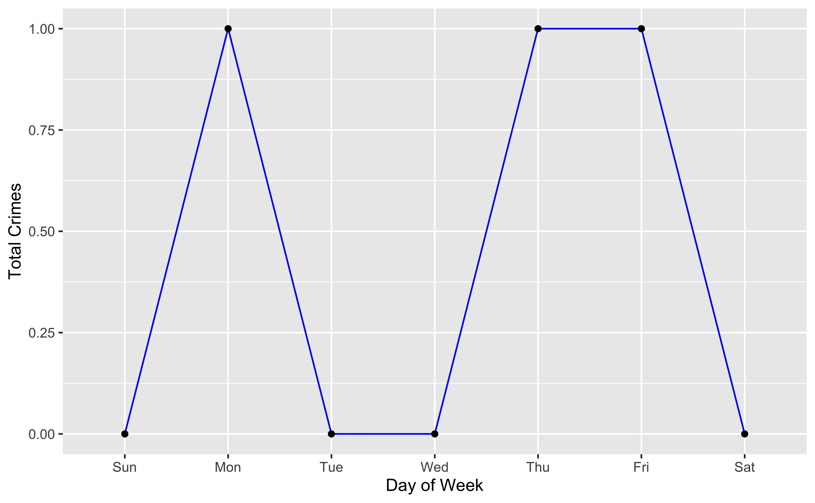
Botanical Heights: Crime by Days of the Week

Slide 11
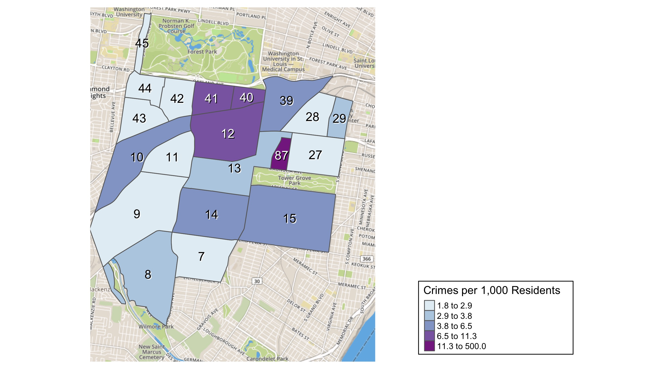
District 2: Crime Rates Map

Slide 12
District 2: Density Map Explanation
There are 23 neighborhoods in District 2. The South Hampton neighborhood is split between District 2 and District 1.
The minimum number of crimes in one neighborhood was 1 (Missouri Botanical Garden)
The maximum number of crimes in one neighborhood was 82 (Tower Grove South)
The mean number of crimes in one neighborhood was 16
The minimum rate of crimes in one neighborhood was 1.82 (Hi-Pointe)
The maximum rate of crimes in one neighborhood was 500 (Missouri Botanical Garden)
The mean rate of crimes in one neighborhood was 29.47

Slide 13
Central West End: Summary Notes
133 total crimes in June 2020
49% change compared to June 2019 (89 total crimes)
12 crime(s) against persons in June 2020
-25% change compared to June 2019 (16 crimes against persons)
565 total crimes in 2020
5% change compared to this time in 2019 (540 total crimes)
68 crime(s) against persons in 2020
-8% change compared to this time in 2019 (74 crimes against persons)

Slide 14
Central West End: Year to Year Comparison
2019 | 2019 | 2019 | 2019 | 2019 | 2019 | 2019 | 2019 | 2019 | 2019 | 2019 | 2019 | 2019 | 2019
Part 1 Crimes | Jan | Feb | Mar | Apr | May | Jun | Jul | Aug | Sep | Oct | Nov | Dec | Total
Aggravated Assault | 9 | 4 | 10 | 2 | 8 | 13 | 4 | 11 | 3 | 8 | 4 | 11 | 87
Arson | 0 | 0 | 1 | 0 | 0 | 0 | 0 | 0 | 0 | 0 | 0 | 0 | 1
Burgalry | 3 | 5 | 5 | 9 | 13 | 8 | 13 | 18 | 8 | 8 | 10 | 5 | 105
Homicide | 0 | 0 | 0 | 0 | 0 | 0 | 0 | 0 | 0 | 0 | 0 | 0 | 0
Larceny | 45 | 66 | 65 | 65 | 72 | 56 | 75 | 81 | 63 | 90 | 89 | 65 | 832
Motor Vehicle Theft | 11 | 7 | 3 | 11 | 12 | 9 | 5 | 11 | 9 | 5 | 19 | 9 | 111
Robbery | 5 | 5 | 2 | 6 | 7 | 3 | 4 | 8 | 3 | 8 | 11 | 10 | 72
Total | 73 | 87 | 86 | 93 | 112 | 89 | 101 | 129 | 86 | 119 | 133 | 100 | 1,208
2020 | 2020 | 2020 | 2020 | 2020 | 2020 | 2020 | 2020
Part 1 Crimes | Jan | Feb | Mar | Apr | May | Jun | Total
Aggravated Assault | 3 | 5 | 3 | 6 | 8 | 5 | 30
Arson | 0 | 0 | 0 | 0 | 0 | 0 | 0
Burgalry | 6 | 4 | 4 | 8 | 7 | 22 | 51
Homicide | 1 | 0 | 0 | 0 | 1 | 0 | 2
Larceny | 53 | 53 | 54 | 63 | 76 | 86 | 385
Motor Vehicle Theft | 5 | 7 | 10 | 15 | 9 | 13 | 59
Robbery | 12 | 8 | 5 | 2 | 4 | 7 | 38
Total | 80 | 77 | 76 | 94 | 105 | 133 | 565

Slide 15
Central West End: Summary Tables
Day of the Week | Number of Crimes
Sun | 18
Mon | 36
Tue | 25
Wed | 17
Thu | 10
Fri | 13
Sat | 14
Total | 133
Part 1 Crimes | Number of Crimes
Aggravated Assault | 5
Burgalry | 22
Larceny | 86
Motor Vehicle Theft | 13
Robbery | 7
Total | 133
Crimes Against Persons | Number of Crimes
FALSE | 121
TRUE | 12
Total | 133
Time of Day | Number of Crimes
Day | 109
Night | 24
Total | 133

Slide 16
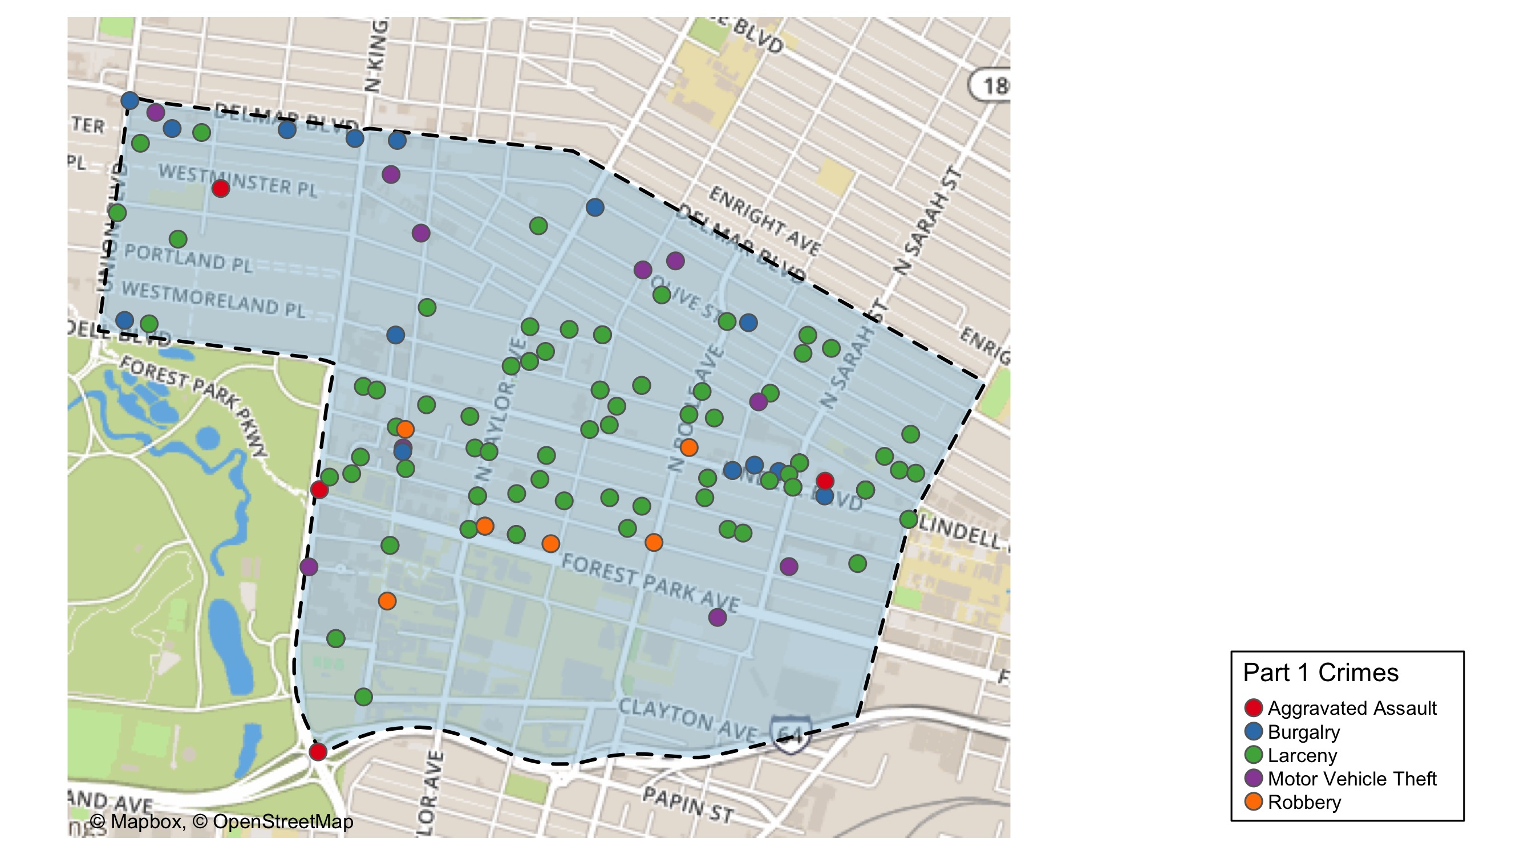
Central West End: Total Crime Map

Slide 17
Washington University Medical Campus: Summary Notes
10 total crimes in June 2020
11% change compared to June 2019 (9 total crimes)
1 crime(s) against persons in June 2020
-67% change compared to June 2019 (3 crimes against persons)
47 total crimes in 2020
-23% change compared to this time in 2019 (61 total crimes)
9 crime(s) against persons in 2020
-10% change compared to this time in 2019 (10 crimes against persons)

Slide 18
Washington University Medical Campus: Year to Year Comparison
2019 | 2019 | 2019 | 2019 | 2019 | 2019 | 2019 | 2019 | 2019 | 2019 | 2019 | 2019 | 2019 | 2019
Part 1 Crimes | Jan | Feb | Mar | Apr | May | Jun | Jul | Aug | Sep | Oct | Nov | Dec | Total
Aggravated Assault | 4 | 1 | 1 | 0 | 0 | 2 | 0 | 5 | 3 | 0 | 1 | 0 | 17
Arson | 0 | 0 | 0 | 0 | 0 | 0 | 0 | 0 | 0 | 0 | 0 | 0 | 0
Burgalry | 0 | 0 | 0 | 0 | 0 | 0 | 0 | 1 | 0 | 0 | 0 | 0 | 1
Homicide | 0 | 0 | 0 | 0 | 0 | 0 | 0 | 0 | 0 | 0 | 0 | 0 | 0
Larceny | 7 | 8 | 6 | 9 | 9 | 6 | 8 | 4 | 11 | 6 | 10 | 10 | 94
Motor Vehicle Theft | 2 | 0 | 1 | 2 | 1 | 0 | 0 | 1 | 2 | 0 | 4 | 2 | 15
Robbery | 0 | 0 | 0 | 1 | 0 | 1 | 0 | 1 | 1 | 1 | 2 | 0 | 7
Total | 13 | 9 | 8 | 12 | 10 | 9 | 8 | 12 | 17 | 7 | 17 | 12 | 134
2020 | 2020 | 2020 | 2020 | 2020 | 2020 | 2020 | 2020
Part 1 Crimes | Jan | Feb | Mar | Apr | May | Jun | Total
Aggravated Assault | 0 | 0 | 2 | 1 | 1 | 0 | 4
Arson | 0 | 0 | 0 | 0 | 0 | 0 | 0
Burgalry | 1 | 0 | 0 | 0 | 0 | 0 | 1
Homicide | 0 | 0 | 0 | 0 | 0 | 0 | 0
Larceny | 8 | 5 | 5 | 3 | 5 | 8 | 34
Motor Vehicle Theft | 0 | 1 | 0 | 1 | 0 | 1 | 3
Robbery | 1 | 3 | 0 | 0 | 0 | 1 | 5
Total | 10 | 9 | 7 | 5 | 6 | 10 | 47

Slide 19
Washington University Medical Campus: Summary Tables
Part 1 Crimes | Number of Crimes
Larceny | 8
Motor Vehicle Theft | 1
Robbery | 1
Total | 10
Type of Larceny | Number of Crimes
All Other | 1
From Building | 5
From Motor Vehicle | 1
From Person | 1
Total | 8
Time of Day | Number of Crimes
Day | 9
Night | 1
Total | 10
Monetary Value | Number of Crimes
$500 - $24,999 | 1
Under $500 | 7
Total | 8

Slide 20
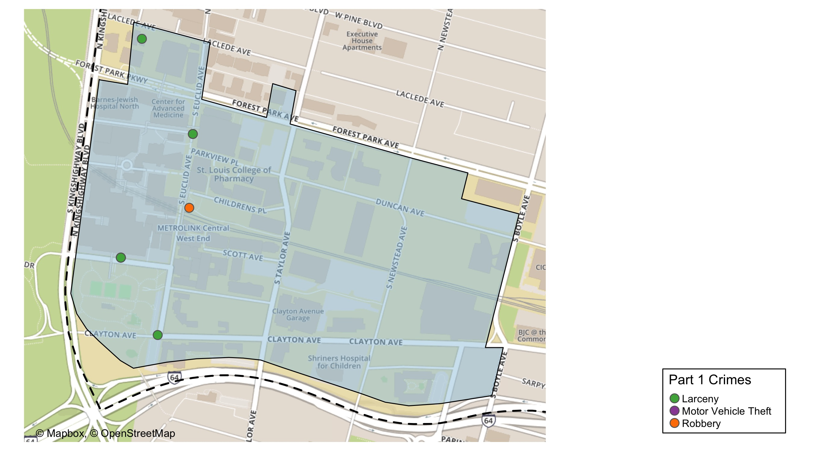
Washington University Medical Center: Total Crime Map

Slide 21
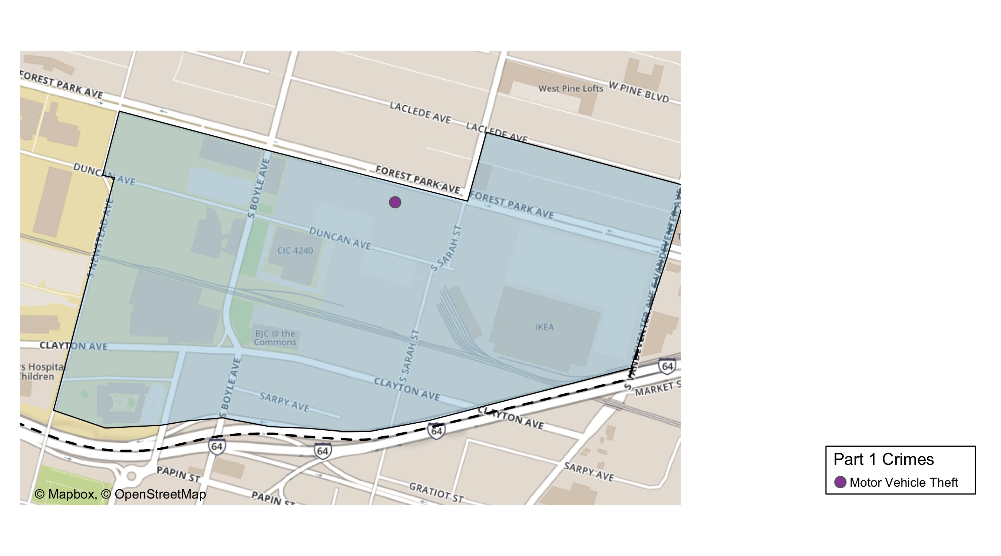
Cortex: Total Crime Map

Slide 22
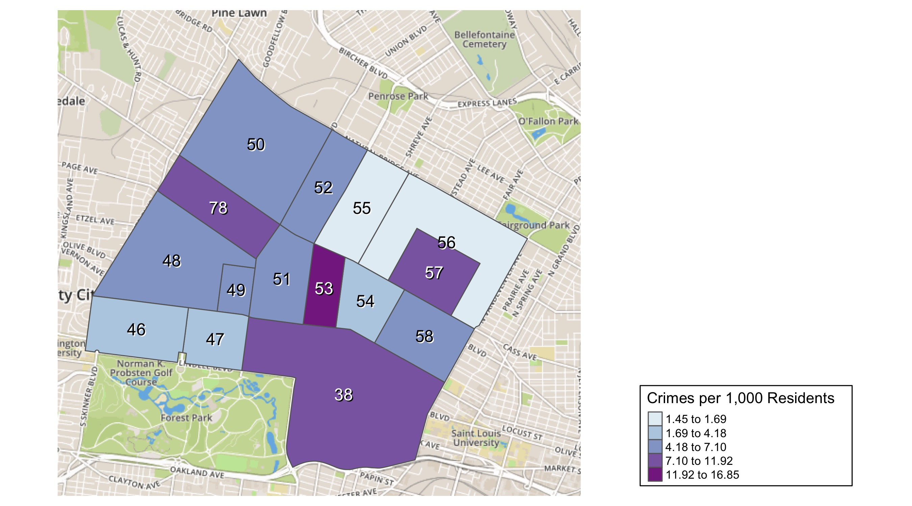
District 5: Crime Rates Map

Slide 23
District 5: Density Map Explanation
There are 15 neighborhoods in District 5
The minimum number of crimes in one neighborhood was 6 (Visitation Park)
The maximum number of crimes in one neighborhood was 133 (Central West End)
The mean number of crimes in one neighborhood was 26.67
The minimum rate of crimes in one neighborhood was 1.45 (Greater Ville)
The maximum rate of crimes in one neighborhood was 16.85 (Fountain Park)
The mean rate of crimes in one neighborhood was 6.73

Slide 24
Forest Park Southeast: Neighborhood Detail
Appendix 1

Slide 25
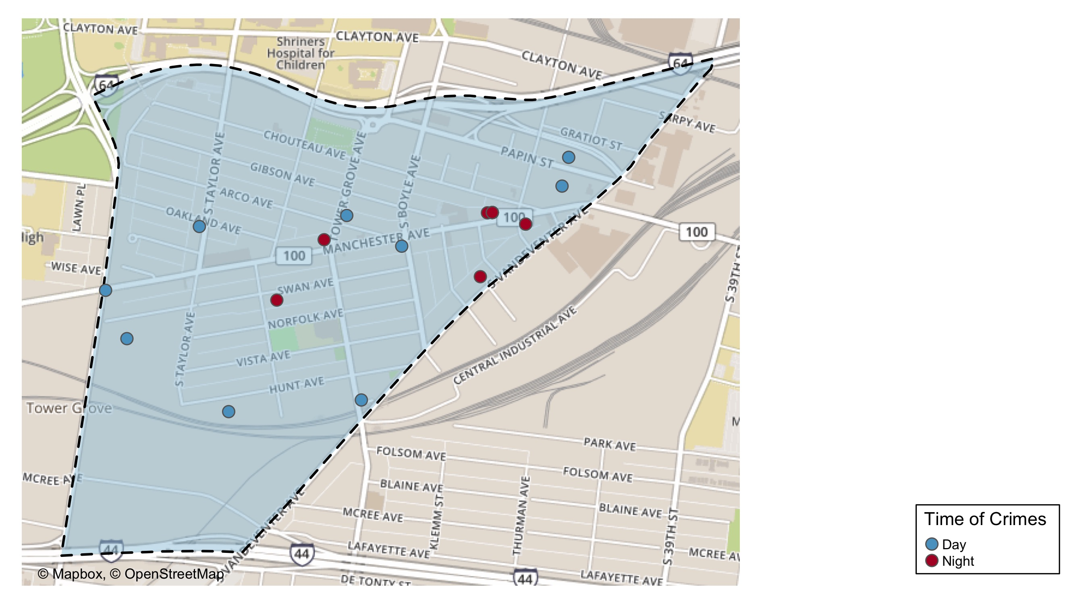
Forest Park Southeast: Time of Crimes Map

Slide 26
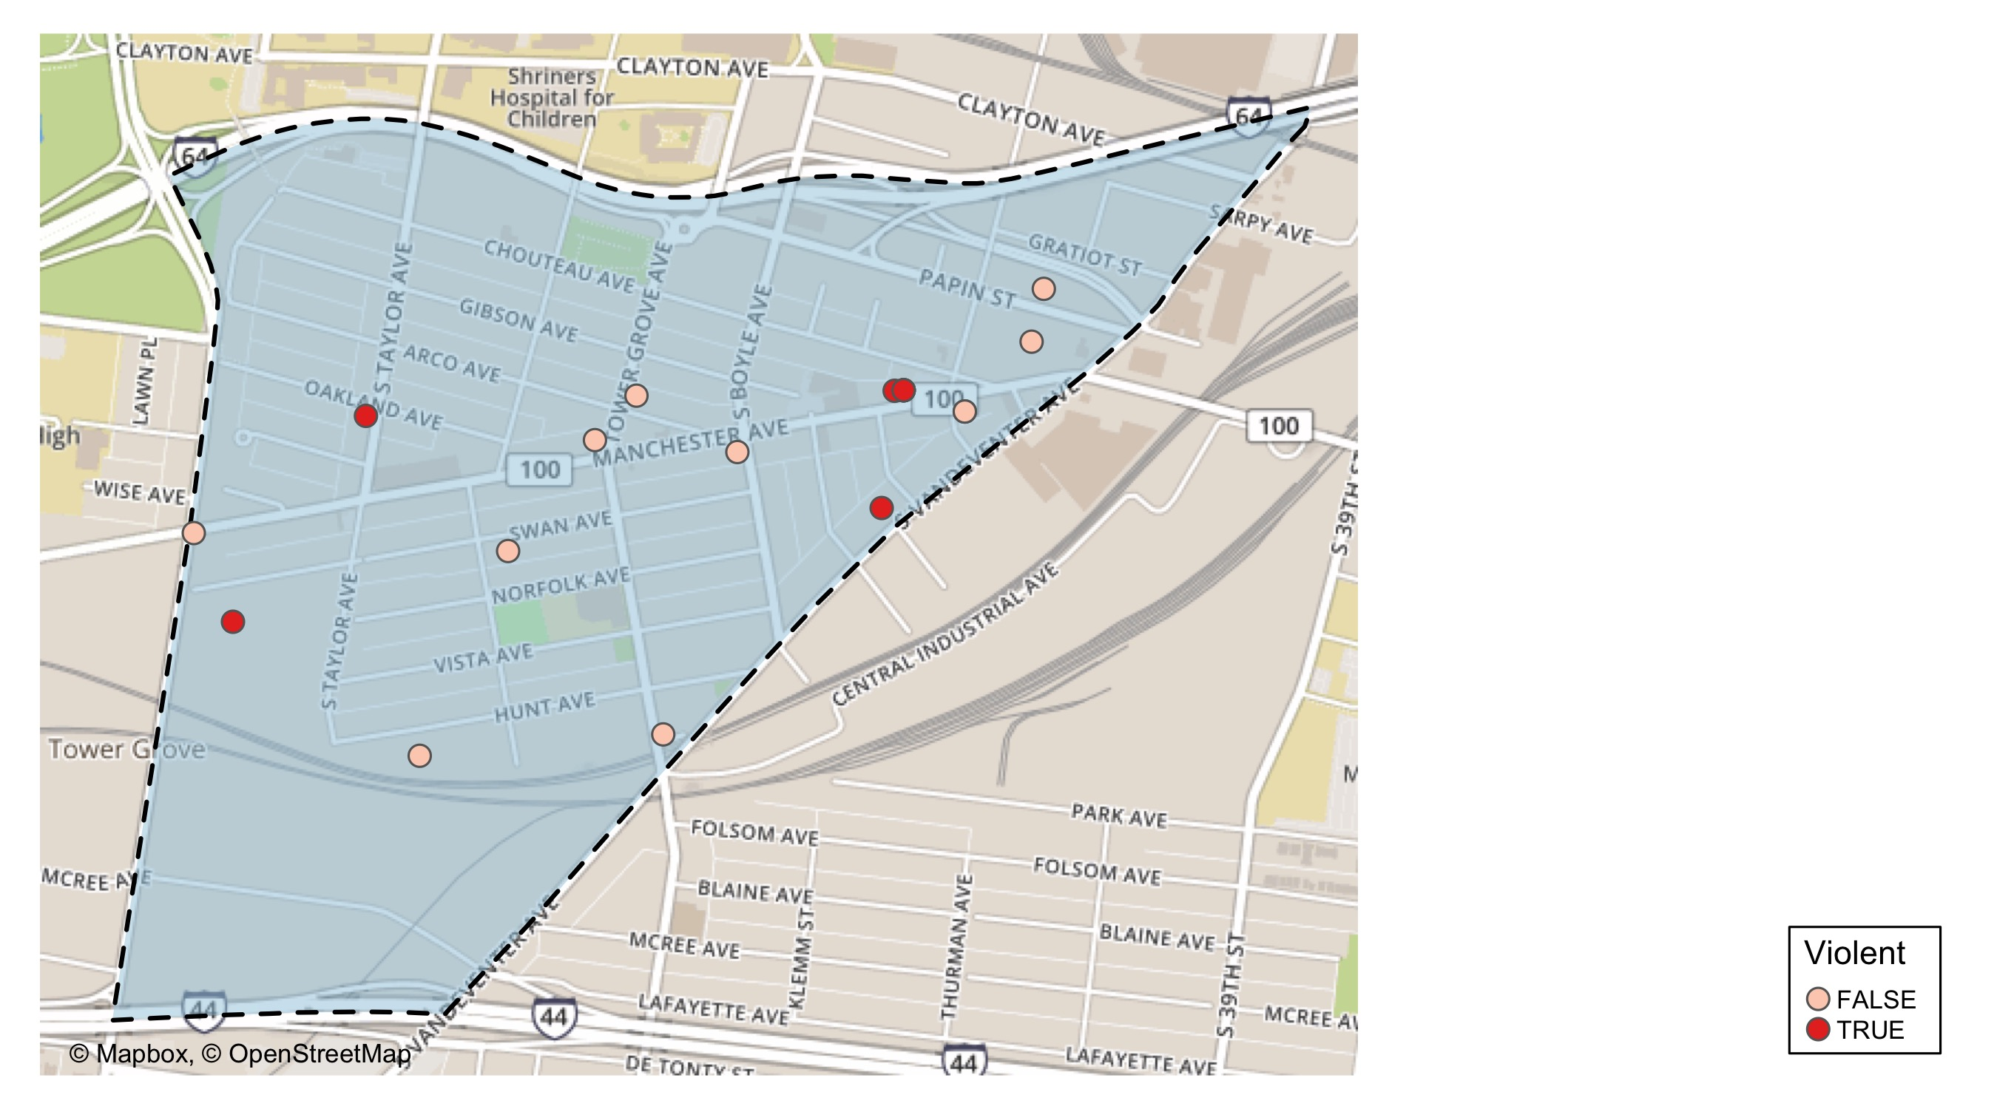
Forest Park Southeast: Violent Crime Map

Slide 27
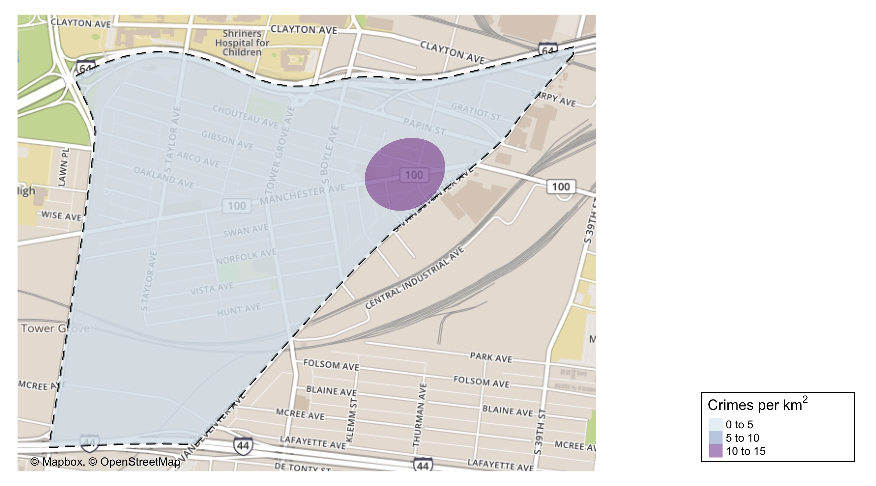
Forest Park Southeast: Crime Density Map

Slide 28
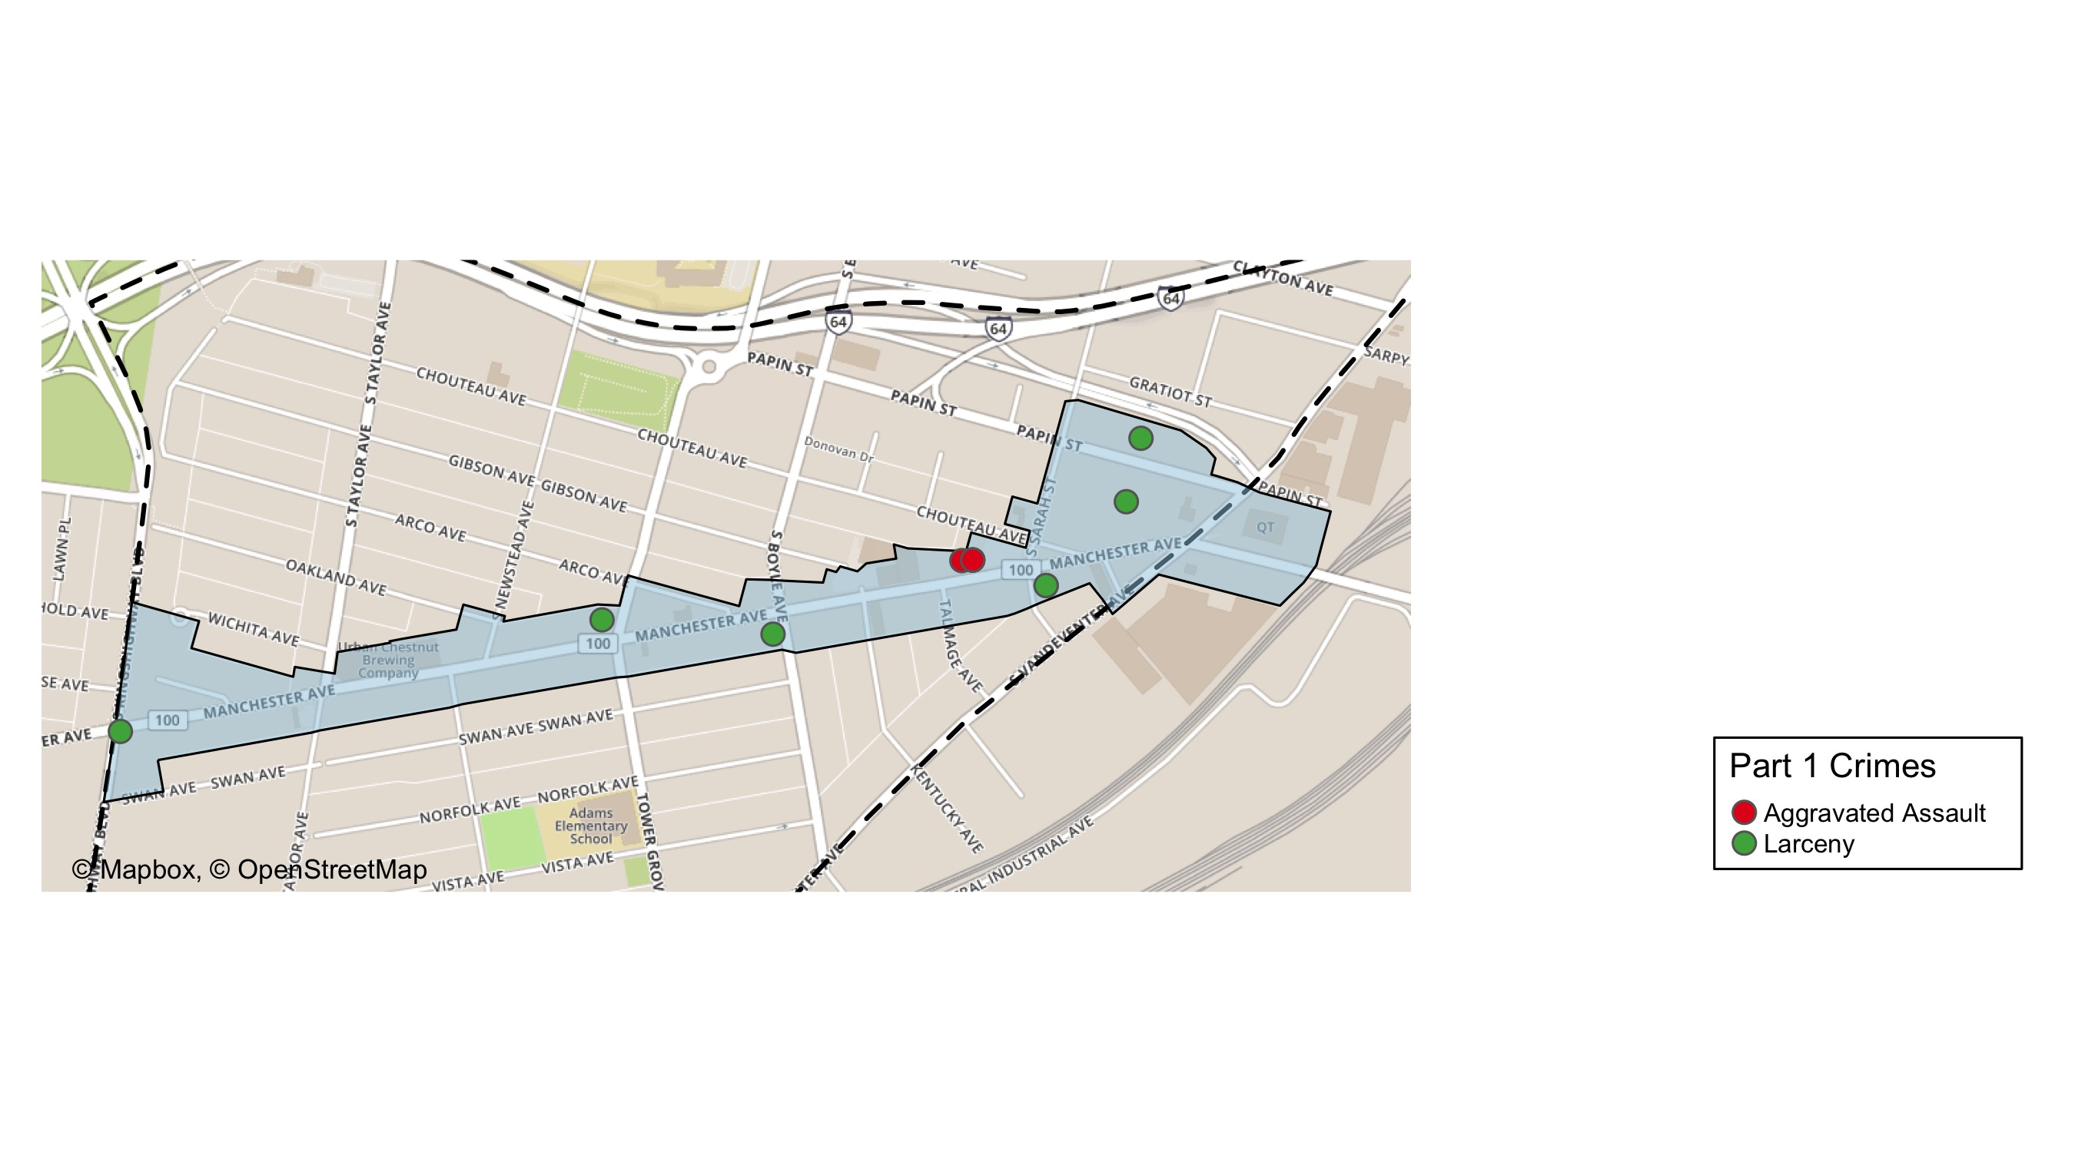
Grove Community Improvement District: Total Crime Map

Slide 29
Forest Park Southeast: Larceny Breakdown
Day of the Week | Number of Crimes
Sun | 2
Mon | 2
Tue | 0
Wed | 3
Thu | 1
Fri | 0
Sat | 3
Total | 11
Type of Larceny | Number of Crimes
All Other | 2
From Building | 1
From Motor Vehicle | 6
Motor Vehicle Parts | 2
Total | 11
Time of Day | Number of Crimes
Day | 7
Night | 4
Total | 11
Monetary | Number of Crimes
$500 - $24,999 | 2
Under $500 | 9
Total | 11

Slide 30
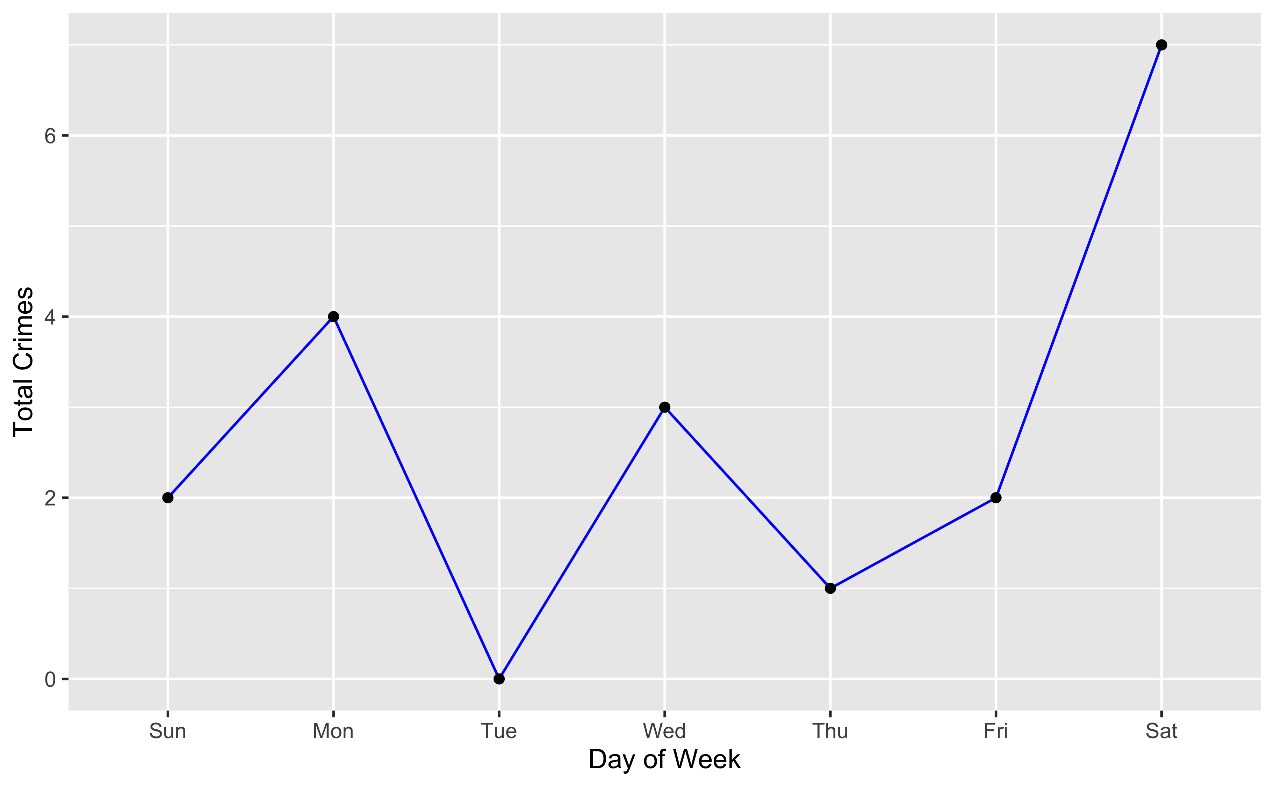
Forest Park Southeast: Total Crimes by Days of the Week

Slide 31
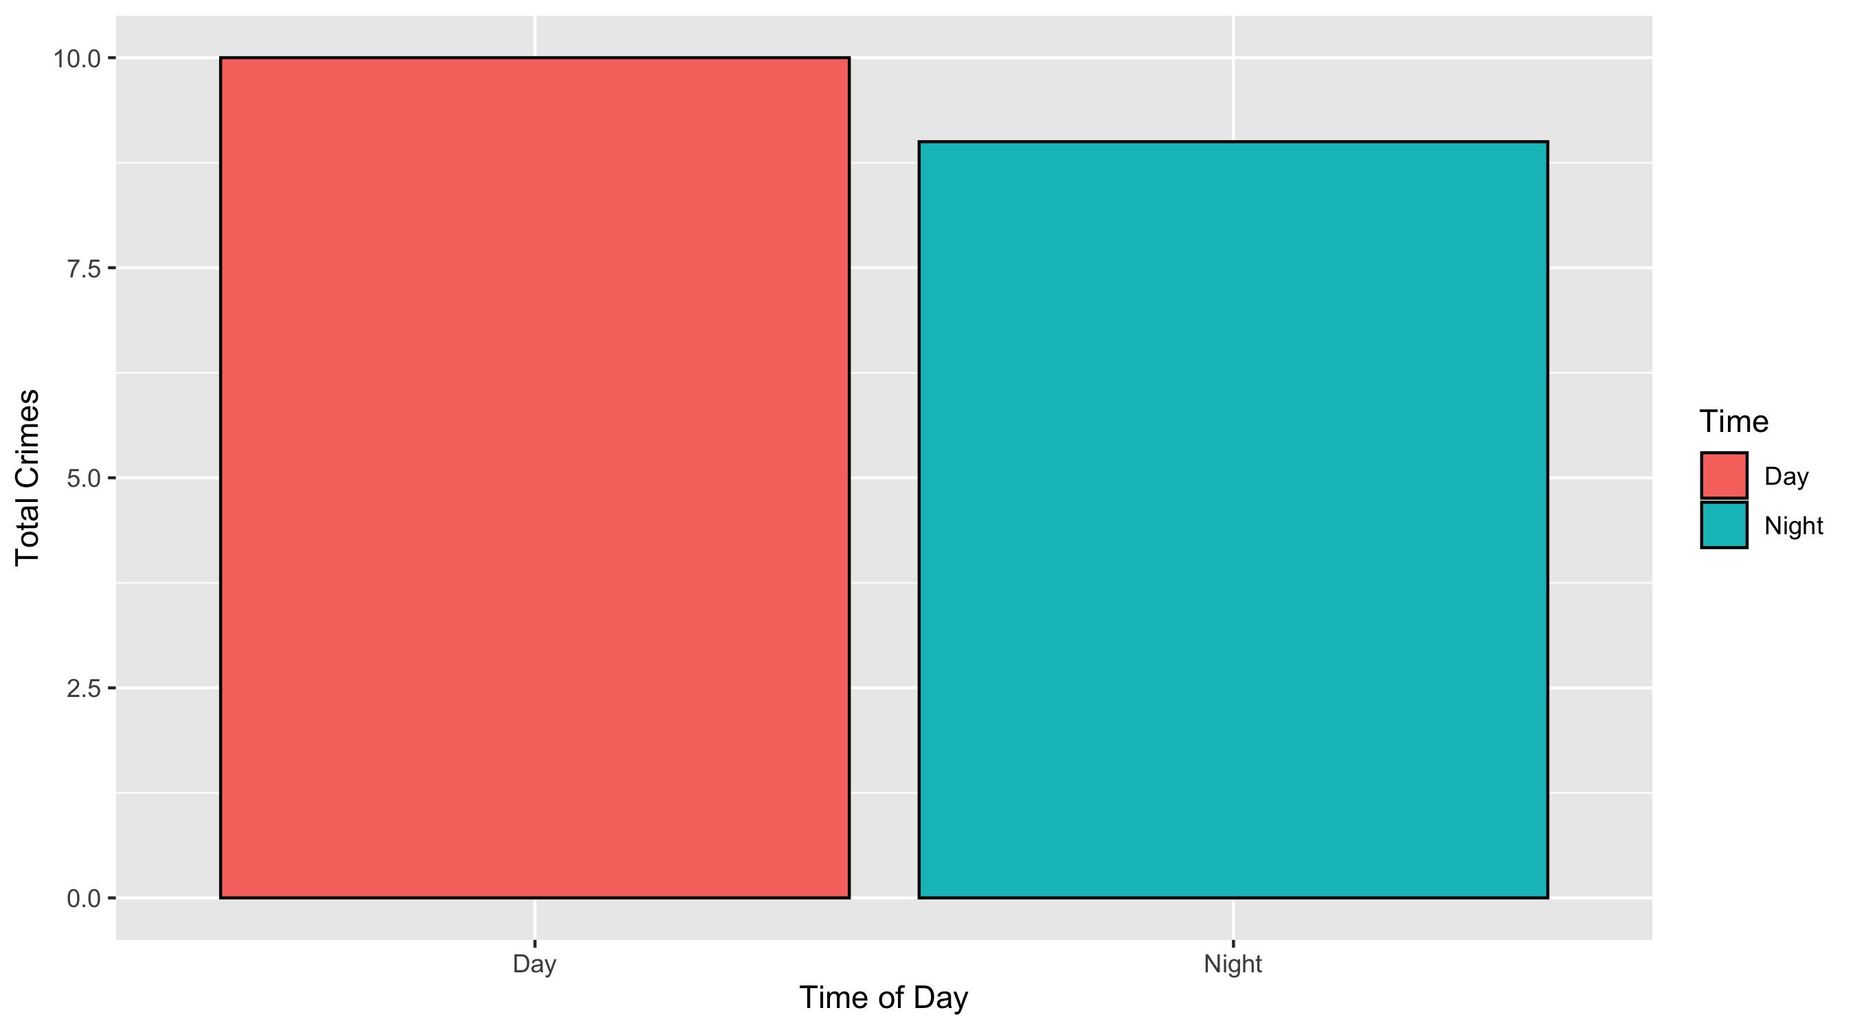
Forest Park Southeast: Crimes by Time of Day

Slide 32
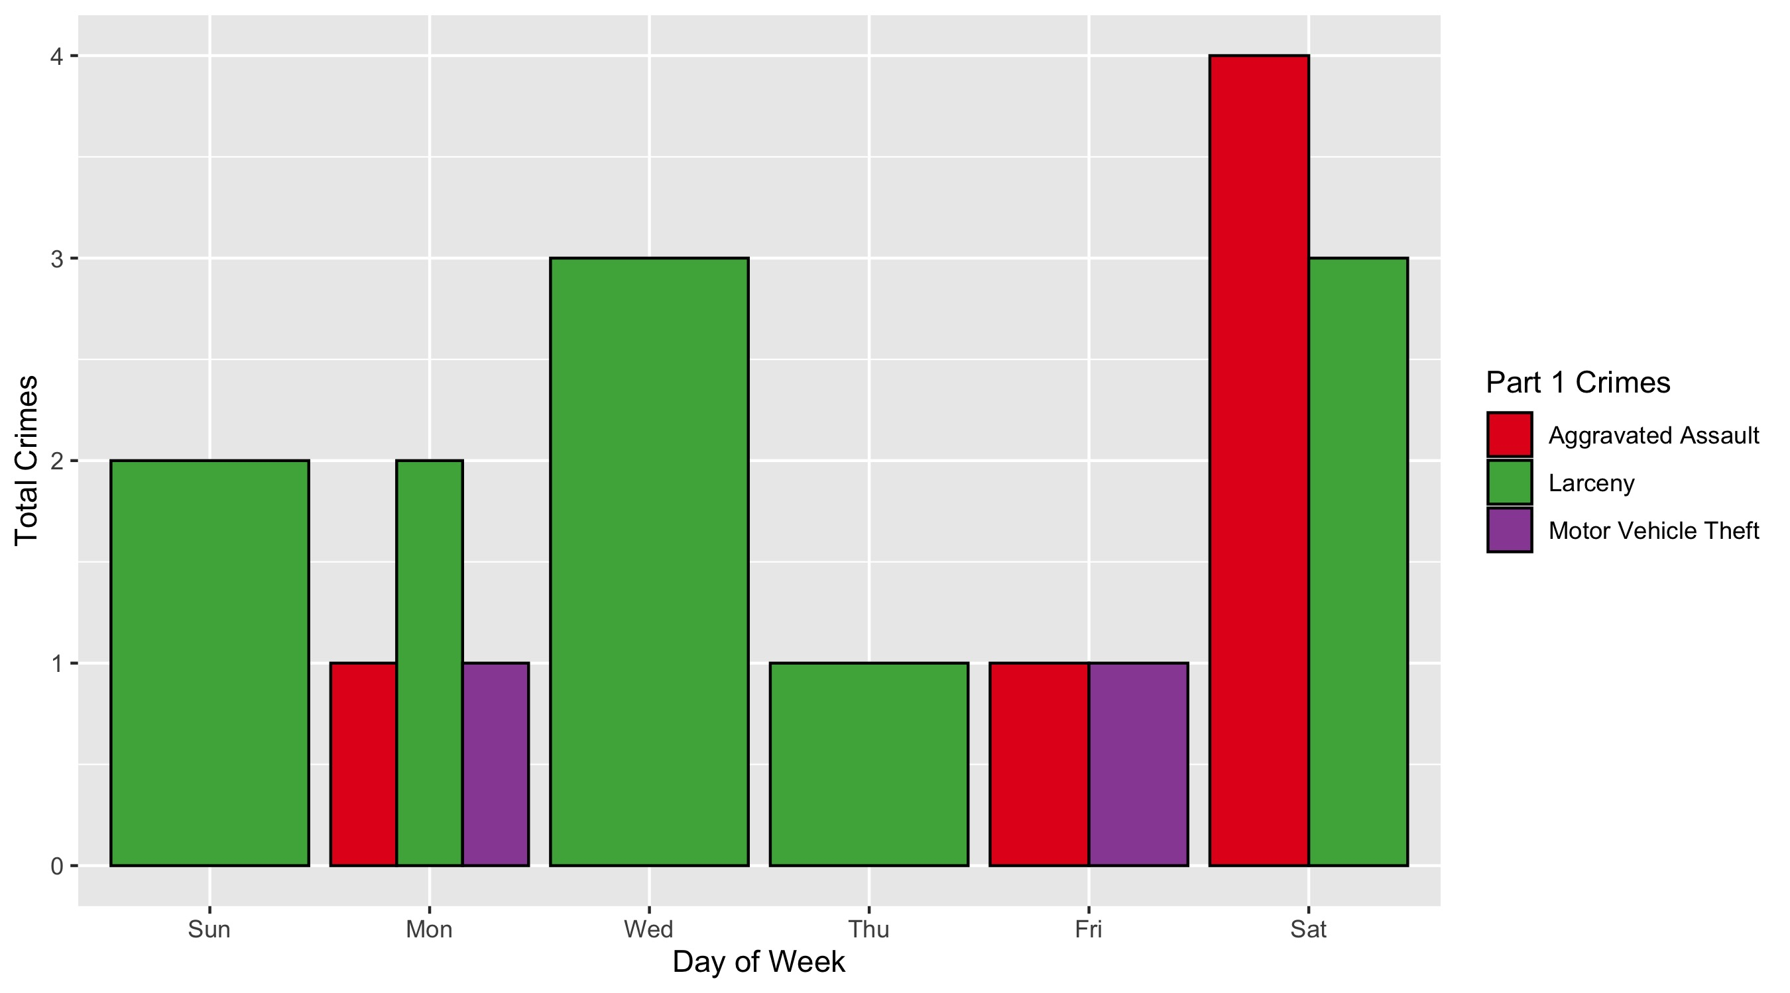
Forest Park Southeast: Crimes by Day & Category

Slide 33
Central West End: Neighborhood Detail
Appendix 2

Slide 34
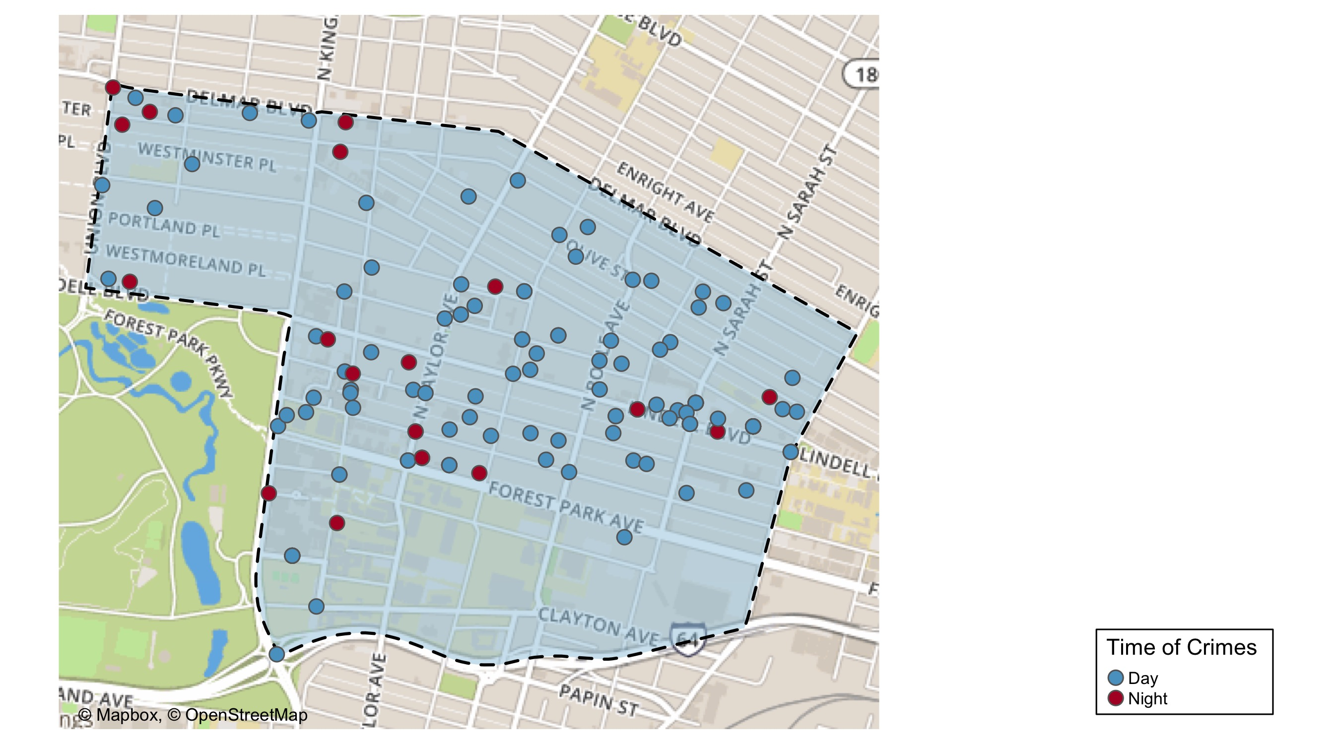
Central West End: Time of Crime Map

Slide 35
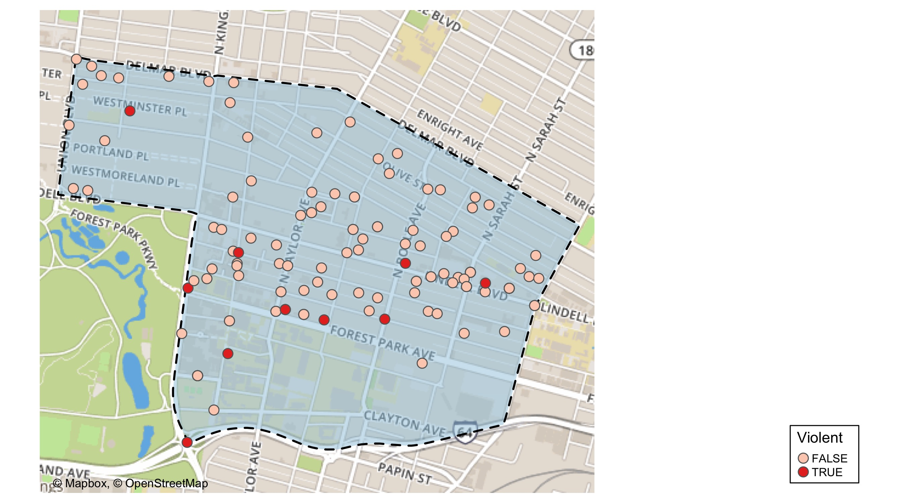
Central West End: Violent Crime Map

Slide 36
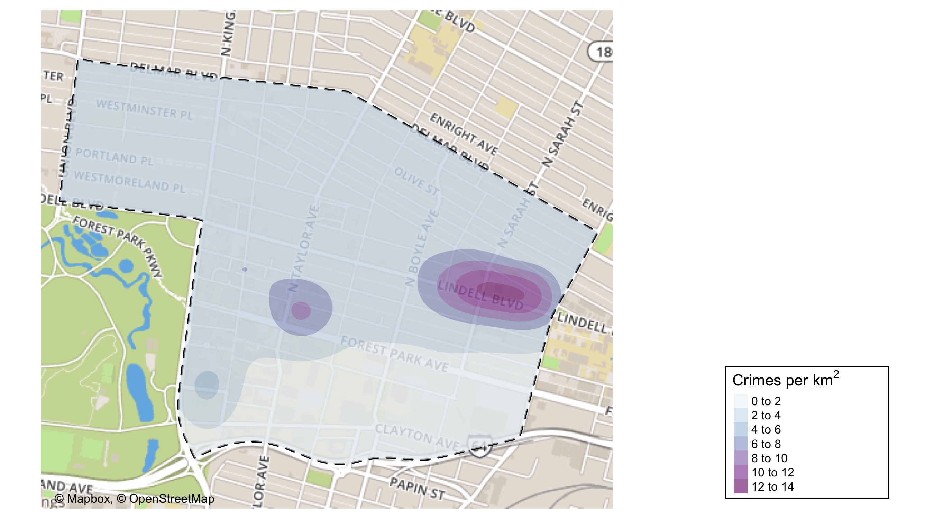
Central West End: Crime Density Map

Slide 37
Central West End: Larceny Breakdown
Day of the Week | Number of Crimes
Sun | 14
Mon | 27
Tue | 10
Wed | 13
Thu | 9
Fri | 8
Sat | 5
Total | 86
Type of Larceny | Number of Crimes
All Other | 8
Bicycle | 1
From Building | 10
From Motor Vehicle | 56
From Person | 2
Motor Vehicle Parts | 8
Shoplifting | 1
Total | 86
Time of Day | Number of Crimes
Day | 79
Night | 7
Total | 86
Monetary Value | Number of Crimes
$500 - $24,999 | 21
Under $500 | 65
Total | 86

Slide 38
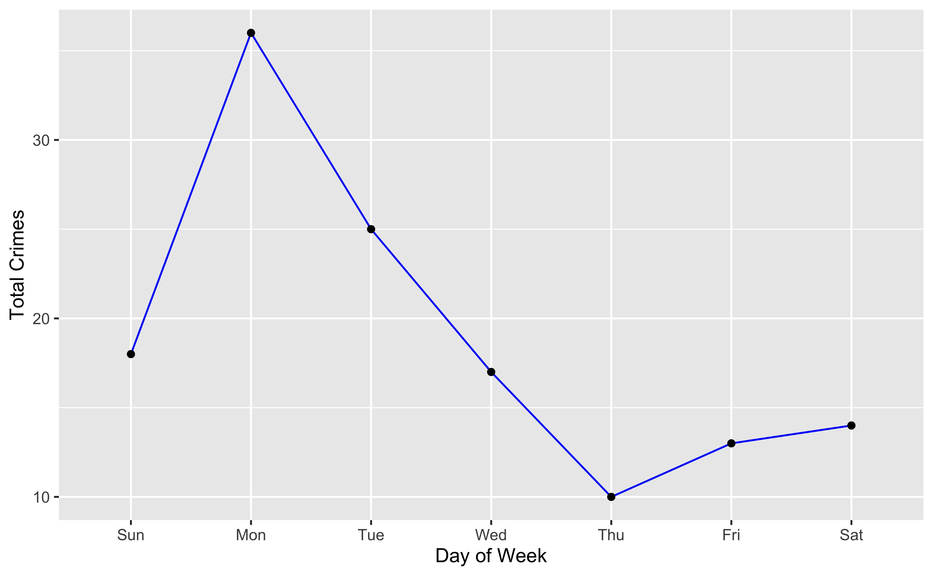
Central West End: Total Crimes by Days of the Week

Slide 39
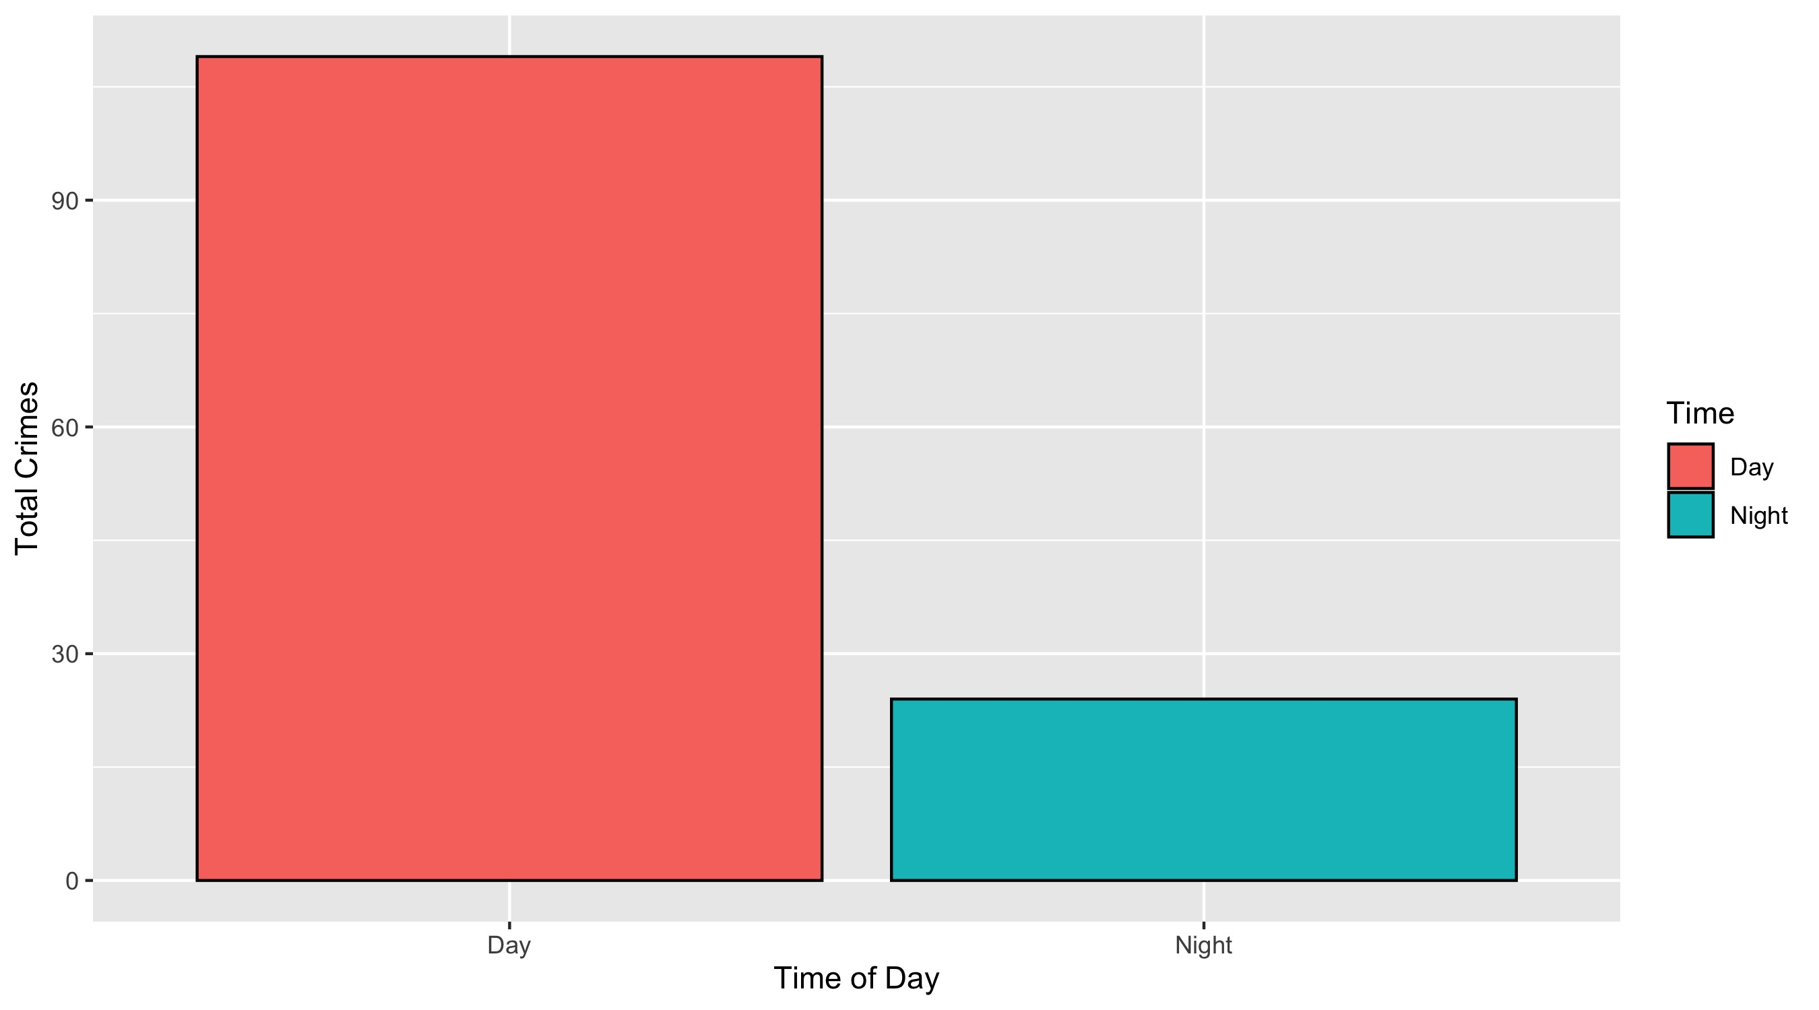
Central West End: Crimes by Time of Day

Slide 40
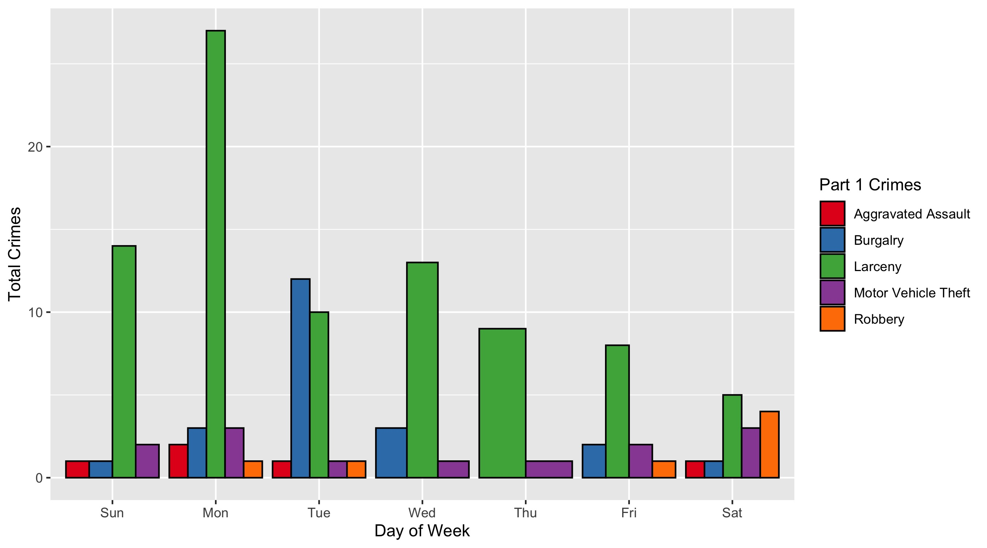
Central West End: Crimes by Day & Category

